Slide 1

ALL-HANDS · H1 2026
NORDWIND KAFFEE
Mid-year all-hands —
2026
Nordwind Kaffee · Berlin · 28 people, one roastery
BERLIN · SPECIALTY COFFEE
JULY 2026

Slide 2

02 TODAY
NORDWIND KAFFEE
What we’ll cover
01
H1 revenue: up 18%
02
Where we’re squeezed
03
Three H2 priorities
04
One risk & what we do
05
Your team’s H2
BERLIN · SPECIALTY COFFEE
02 / 12

Slide 3

03 H1 2026
NORDWIND KAFFEE
Revenue: €2.4M, up 18%
Online now accounts for one-third of our business, up from 28% last year.
€2.4M
+18%
33%
Total H1 revenue
vs H1 2025
Online share of revenue (was 28%)
BERLIN · SPECIALTY COFFEE
03 / 12

Slide 4

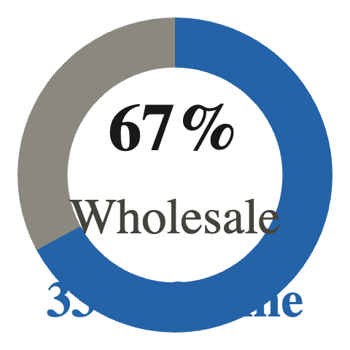
04 BREAKDOWN
NORDWIND KAFFEE
Wholesale holds steady; online accelerates
WHOLESALE
REVENUE SPLIT
€1.6M
+9% vs H1 2025 · 67% of revenue
ONLINE
€0.8M
+41% vs H1 2025 · 33% of revenue
BERLIN · SPECIALTY COFFEE
04 / 12

Slide 5

05 THE SQUEEZE
NORDWIND KAFFEE
We’re running hot — two warning signs
Good problems, but they need attention now.
CAPACITY
COSTS
92% roastery utilisation
Green coffee +22%
We’re close to the ceiling. Late deliveries doubled in June: 31
late orders vs 14 in May.
Margin fell from 34% to 29%. We’re absorbing more than we
can sustainably carry.
BERLIN · SPECIALTY COFFEE
05 / 12

Slide 6

06 MARGIN
NORDWIND KAFFEE
THE NUMBERS
34%
29%
→
H1 2025 margin
H1 2026 margin
Green coffee costs up 22% — we’ve held prices steady, but that’s not a
long-term answer.
BERLIN · SPECIALTY COFFEE
06 / 12

Slide 7

07 PRIORITY 1
NORDWIND KAFFEE
H2 PRIORITY
Second roaster installed by October
INVESTMENT
CAPACITY INCREASE
€180k
+60%
This brings our total roastery capacity to 1.6× current output — enough headroom
for the next 18 months of growth.
BERLIN · SPECIALTY COFFEE
07 / 12

Slide 8

08 PRIORITY 2
NORDWIND KAFFEE
H2 PRIORITY
Wholesale prices up ~6% from September
We’ve held our wholesale price for 18 months. This adjustment reflects the
22% rise in green coffee costs and protects our margin without passing on the
full increase.
Effective 1 September 2026 · communicated to
cafes in August
BERLIN · SPECIALTY COFFEE
08 / 12

Slide 9

09 PRIORITY 3
NORDWIND KAFFEE
H2 PRIORITY
Subscription v2 launches in November
A simpler, more flexible subscription experience for our online customers.
WHAT’S NEW
WHAT’S NEW
WHAT’S NEW
Pause & swap
Flexible frequency
Better onboarding
Customers can pause delivery or swap
beans anytime without contacting
support.
Choose weekly, biweekly or monthly —
with a discount that scales with
commitment.
A three-question taste quiz so new
subscribers get beans they’ll love from
the first bag.
BERLIN · SPECIALTY COFFEE
09 / 12

Slide 10

10 RISK
NORDWIND KAFFEE
HONEST ABOUT RISK
Two wholesale clients renegotiate in Q4
COMBINED REVENUE
WHAT WE’RE DOING
19%
Strengthening relationships now · preparing alternative terms
· diversifying our wholesale base
We’re not assuming these contracts will renew as-is. We’re preparing three
scenarios and will keep the team updated as talks progress.
BERLIN · SPECIALTY COFFEE
10 / 12

Slide 11

11 YOUR H2
NORDWIND KAFFEE
What each team can do this half
Our priorities need everyone pulling in the same direction.
ROASTERY & LOGISTICS
SALES
ONLINE SHOP & MARKETING
Prep for the second roaster
Own the price conversation
Build the subscription
launch
Plan the installation, train on the new
machine and refine our workflow so
we hit October with zero downtime.
Talk to cafe partners early about the
September price adjustment. Be
honest, be clear and protect the
relationship.
Test the new flow, gather feedback
from early users and plan the
November go-to-market. Make it feel
like an upgrade, not a change.
BERLIN · SPECIALTY COFFEE
11 / 12

Slide 12

12 CLOSE
NORDWIND KAFFEE
ONE MORE THING
We’re in a strong position. Let’s
use it.
Thank you for everything you’ve done in the first half. The second half is
ours to shape.
Nordwind Kaffee · July 2026
BERLIN · SPECIALTY COFFEE
12 / 12

