Slide 1

QBR
NORTHWIND MOBILITY
Q2 confirms scalable
momentum
Northwind Mobility closed Q2 2026 with faster revenue growth, a larger subscriber
base, lower churn and improving fleet utilization.
EXECUTIVE BOARD
Q2 2026
Notes:
Open with the conclusion: Q2 was a strong operating quarter. The board should see this as momentum that is worth funding, while still managing the execution constraints in H2.

Slide 2

02 KPI OVERVIEW
NORTHWIND MOBILITY
Core KPIs moved in the right
direction
€8.4M
38.2k
3.1%
76%
Revenue, up 21% versus Q1.
Active subscribers, up 14%.
Churn, down from 3.8%.
Fleet utilization across
markets.
EXECUTIVE BOARD
02 / 09
Notes:
The headline is balanced: more revenue, more subscribers, lower churn and higher utilization. Q2 was not only growth; it was healthier growth.

Slide 3
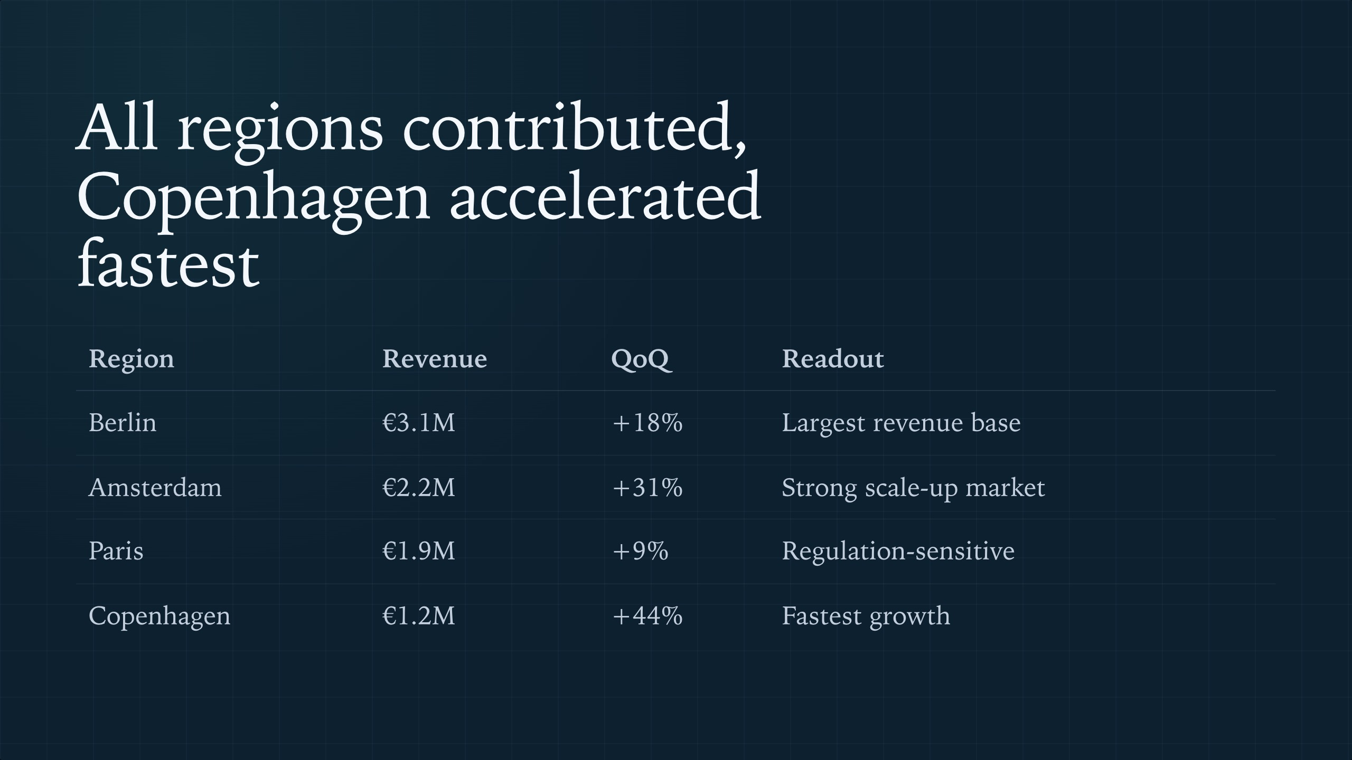
03 REGIONAL PERFORMANCE
NORTHWIND MOBILITY
EXECUTIVE BOARD
03 / 09
Notes:
Berlin remains the anchor, but the growth story is increasingly multi-market. Copenhagen is the small base with the strongest acceleration, while Paris requires closer regulatory management.

Slide 4

04 REVENUE MIX
NORTHWIND MOBILITY
Revenue mix is anchored by
Berlin
Berlin
€3.1M
Amsterdam
€2.2M
Paris
€1.9M
Copenhagen
€1.2M
EXECUTIVE BOARD
04 / 09
Notes:
The bar chart makes the revenue concentration visible without overcomplicating the message. Berlin and Amsterdam together are the core engine, while Copenhagen is the growth option to watch.

Slide 5

05 H2 PRIORITIES
NORTHWIND MOBILITY
H2 depends on three scalable
bets
CARGO TIER
CORPORATE FLEETS
MAINTENANCE
Launch in September
Pilots are signed
Costs can fall
Beta in July tests pricing, operations
and demand before full release.
Two DAX companies create a credible
route into enterprise demand.
Predictive rollout targets an estimated
12% workshop cost reduction.
EXECUTIVE BOARD
05 / 09
Notes:
These initiatives are deliberately connected to growth quality. Cargo bikes expand the product, corporate fleets diversify channels, and predictive maintenance protects margin.

Slide 6

06 CARGO TIER
NORTHWIND MOBILITY
PRODUCT EXPANSION
The cargo-bike tier turns household
logistics into a premium subscription
use case, with the July beta de-
risking a September launch.
EXECUTIVE BOARD
06 / 09
Notes:
This is the clearest product-led growth move in H2. The key is to use the beta to validate operations and avoid scaling complexity faster than demand.

Slide 7

07 ENTERPRISE AND MARGIN
NORTHWIND MOBILITY
Partnerships and maintenance
improve resilience
DEMAND CHANNEL
COST BASE
Corporate fleets reduce acquisition friction
Predictive maintenance protects unit
economics
October rollout converts two DAX pilots into a repeatable
enterprise motion.
December go-live targets 12% lower workshop costs at scale.
EXECUTIVE BOARD
07 / 09
Notes:
H2 is not just about adding subscribers. The corporate and maintenance streams should improve the durability of growth by lowering acquisition friction and operational cost pressure.

Slide 8

08 RISK CONTROL
NORTHWIND MOBILITY
Execution risks are visible and
manageable
− RISK
− RISK
− RISK
Battery lead times doubled
Paris regulation is pending
Insurance costs rose 9%
6 to 11 weeks requires allocation
discipline before cargo launch.
Slow growth could worsen if new rules
restrict operations.
Claims economics need sharper fleet
and rider controls.
+ ACTION
+ ACTION
+ ACTION
Lock suppliers and prioritize launch
markets.
Prepare compliance and scenario
triggers.
Use maintenance data in renewal
talks.
EXECUTIVE BOARD
08 / 09
Notes:
None of the risks changes the strategic direction, but each can affect timing or margin. The message is not to slow down; it is to sequence H2 with clear controls.

Slide 9

09 H2 ROADMAP
NORTHWIND MOBILITY
H2 turns momentum into
controlled expansion
Month | Milestone | Board focus
July | Cargo-bike beta | Validate demand and operations
September | Cargo tier launch | Approve launch readiness
October | Partnership rollout | Convert DAX pilots
December | Maintenance live | Capture cost reduction
EXECUTIVE BOARD
09 / 09
Notes:
Close with the operating plan and the board ask implied by the roadmap. H2 should be managed as a sequenced expansion: beta, launch, enterprise rollout and cost-system go-live.

